Slide 1
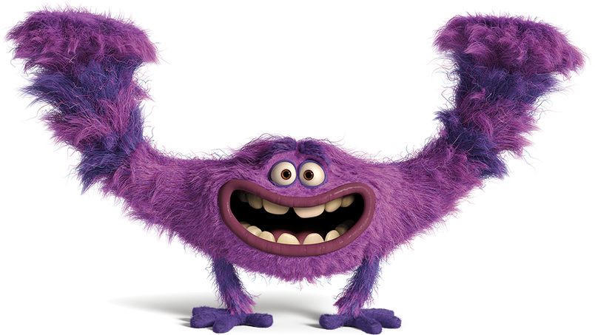
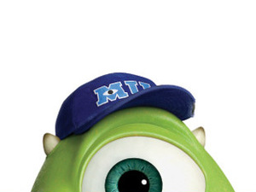
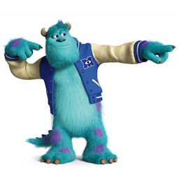
Taming the Test Monsters at (Your School HERE)

Slide 2
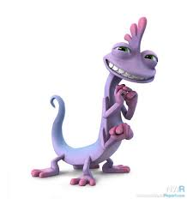
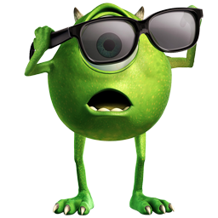

Test Monsters are Real?!
Taking a test can be scary.
  What if I fail? What if I run out of time?
Don’t let them win!
  If you give up, panic, or rush through your test, the monsters have all of the power.
  Take control.
  You will be .

Slide 3
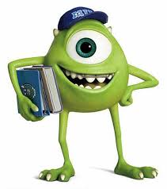
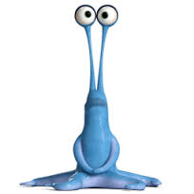
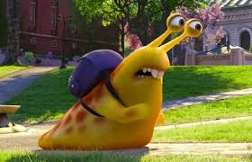
But How?
No worries!
Your school counselor is here to help!
There are some easy tricks to help defeat your test monsters.
  Even if you feel that you are behind, you can find ways to catch up!

Slide 4
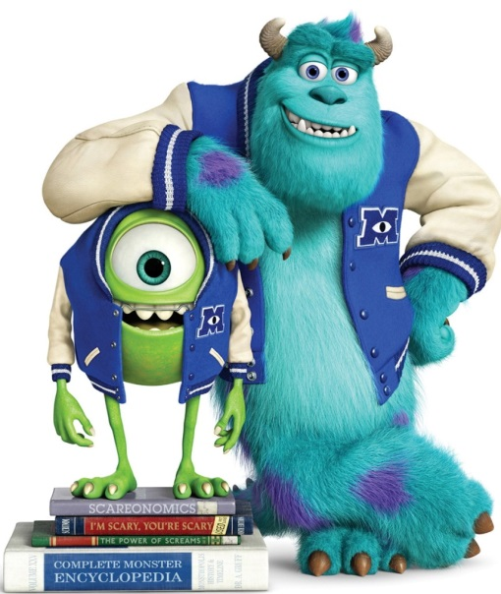
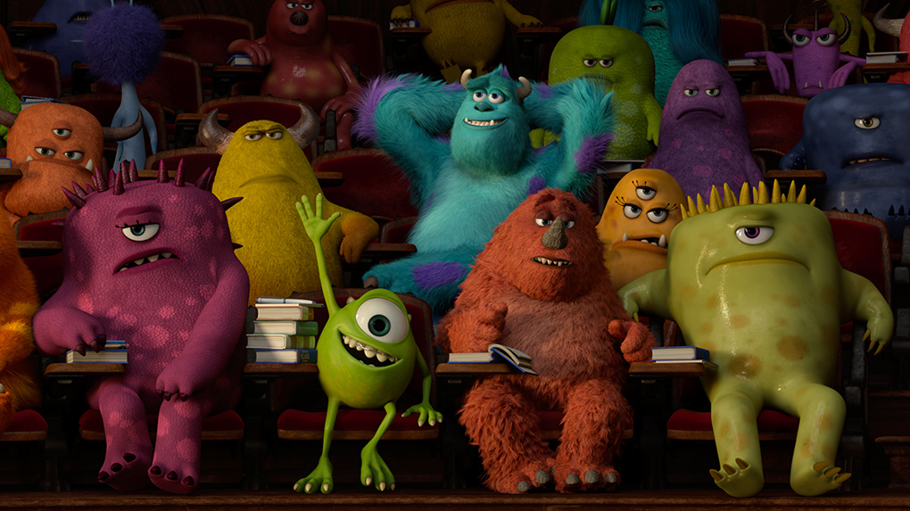
How to Train
You can start training now!
  It’s never too late to make a change.
  Participate! Lower risk than waiting until the test to check your understanding.
Know your monster!
  If you know what scares you the most, you will know how to outsmart it.

Slide 5
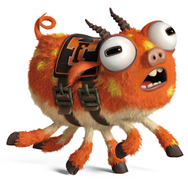
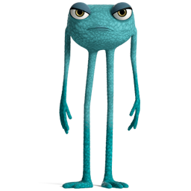
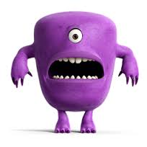
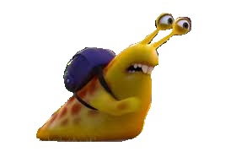
What’s Your test Monster?

Slide 6
Focus Test Monsters
Silly Monster
  Like to be entertained
  Testing feels like reading a dictionary
  “I just want to be done so I can relax and be with my friends!”
SQUIRREL! Monster
  Very hard to focus, easily distracted
  Testing feels like running a marathon
  “I can’t stop thinking about other things…hmm, I wonder what’s for lunch?”

Slide 7
Mood Test Monsters
Mad Monster
  Angry and irritable
  Testing feels like petting a porcupine
  “I can’t believe they are making me do this! This is such a waste of my time.”
Sad Monster
  Low energy
  Testing feels like being in trouble
  “I just want to go home.”

Slide 8
Speed Test Monsters
“I’m So Smart” Monster
  Want to finish first to look smart
  Testing feels like acting in a play
  “If I finish first, I will look like one of the smartest kids in class.”
“Take My Time” Monster
  Not wanting to make a mistake
  Testing feels like jumping over a pool of alligators
  “Good. I answered all of the questions.
  Oh wait, let me check again.”

Slide 9
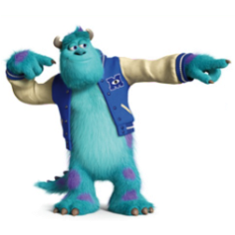
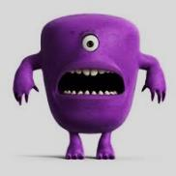
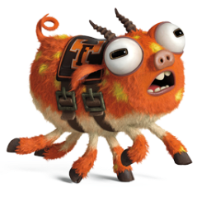
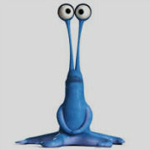
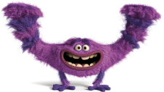
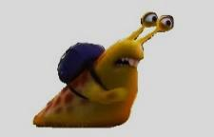
Tame the Test Monsters!
You can do it!
  Here are some ideas that you can try…

Slide 10
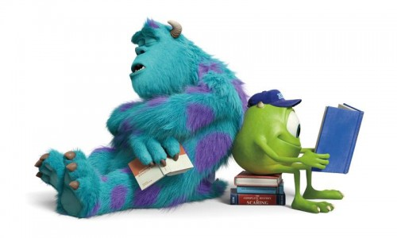
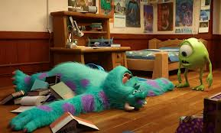
Take a Break.
Breaks are important
  Attention is usually your age + 2
  We remember the 1st thing we learn and the last thing we learn the best, so more breaks = more information that we can remember
Good Study Habits
  Waiting until the last minute to study won’t work very well. It takes time to build memory.

Slide 11
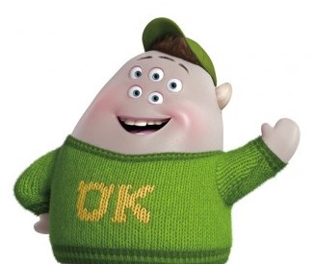
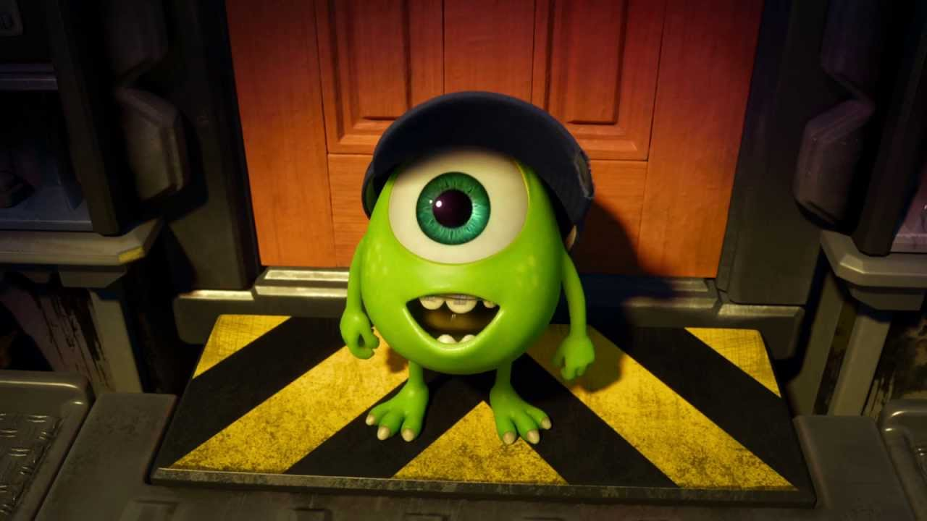
Memory Challenge
Keep your eyes open!
See how many of these objects that you can remember.
Number your paper from 1-12

Slide 12




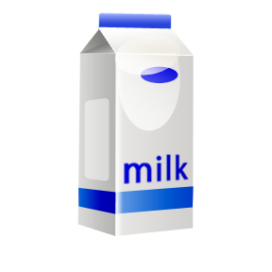

Write Down what you can remember

Slide 13
Write Down what you can remember
Ready to try again?

Slide 14
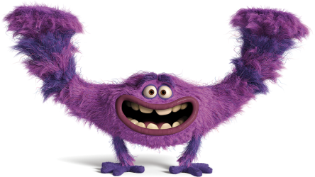

Also Help Your Memory By…
Studying in an accent or funny voice.
Singing what you are trying to remember
Dressing comfortably
  If you’re too cold or too hot, you won’t be able to think about anything else.
  Try wearing layers!

Slide 15
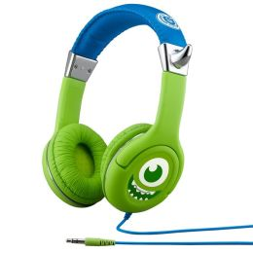
Also Help Your Memory By…
Looking up and to the left to remember notes.
Using “headphones”
  Plug your ears to take away distractions.
  It can help you remember your teacher’s voice and a lesson you learned.

Slide 16
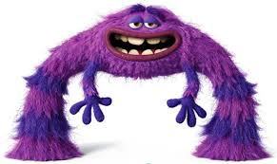


Also Help Your Memory By…
Massaging above your eyebrow
  Also stretching your calf muscle or massaging your shoulders
Peppermint, cinnamon, and lemon
  These tastes and smells are great for memory!
  Peppermint also helps keep you alert and focused.

Slide 17
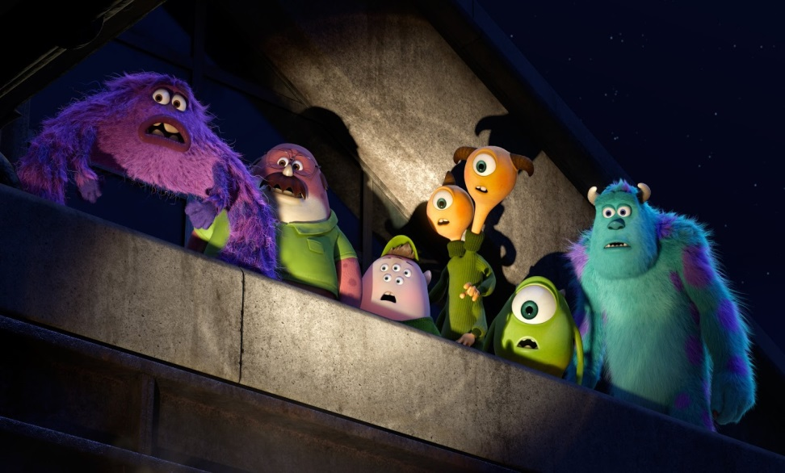
The Night Before
Get enough sleep!
  A tired brain is a foggy brain.
  Tests are tiring. If you don’t have enough sleep, it’s like you’re climbing a mountain after running 20 miles.
Having a hard time falling asleep? Try these tips:
  Listen to music.
  Turn off the TV and computer.
  Meditate.
  Don’t eat right before bed.

Slide 18
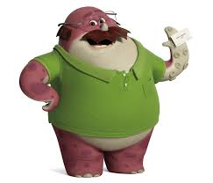
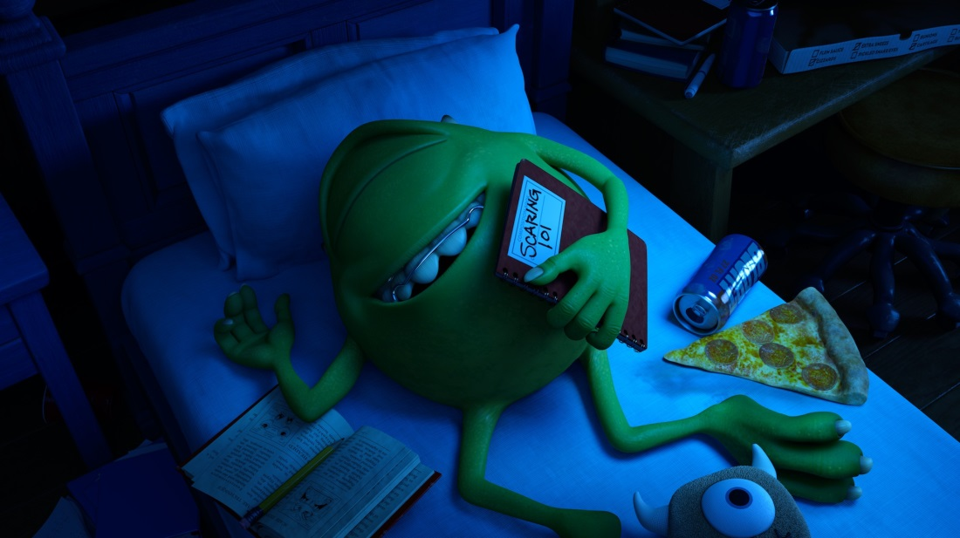
Crunching and Munching
You are what you eat.
  Sugar gives you bursts of energy, but then you crash. You end up feeling more tired than you did before eating the sugar.
  Sugar turns your brain into a “messy room.”
What to avoid:
  Sugary cereal
  Sweets
  Soda

Slide 19
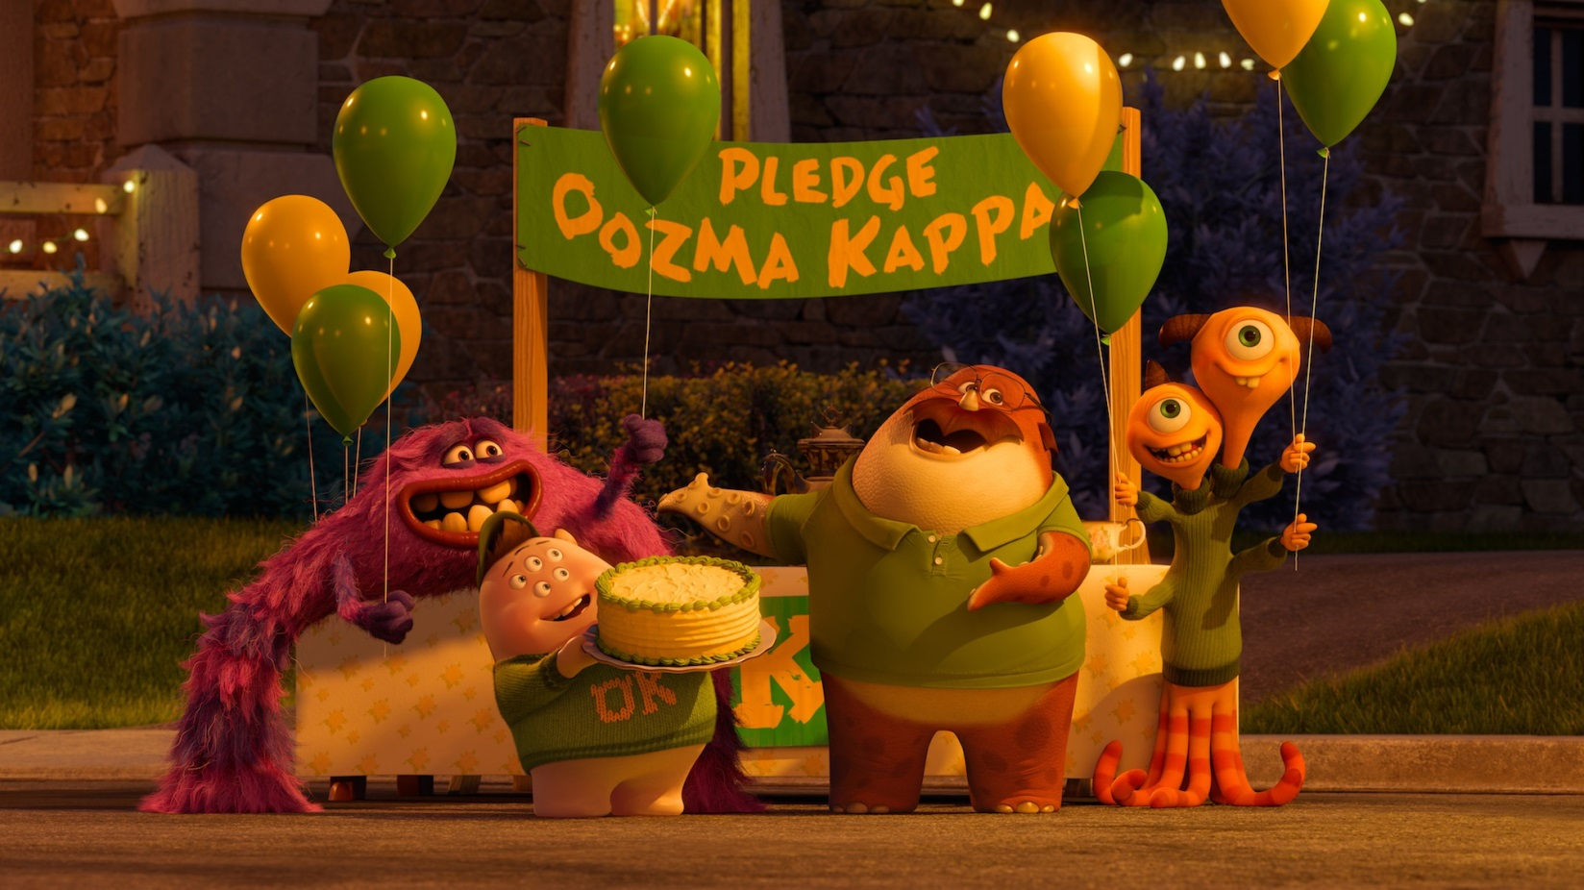
When the Test is Over…
You can eat your cake. It’s .

Slide 20

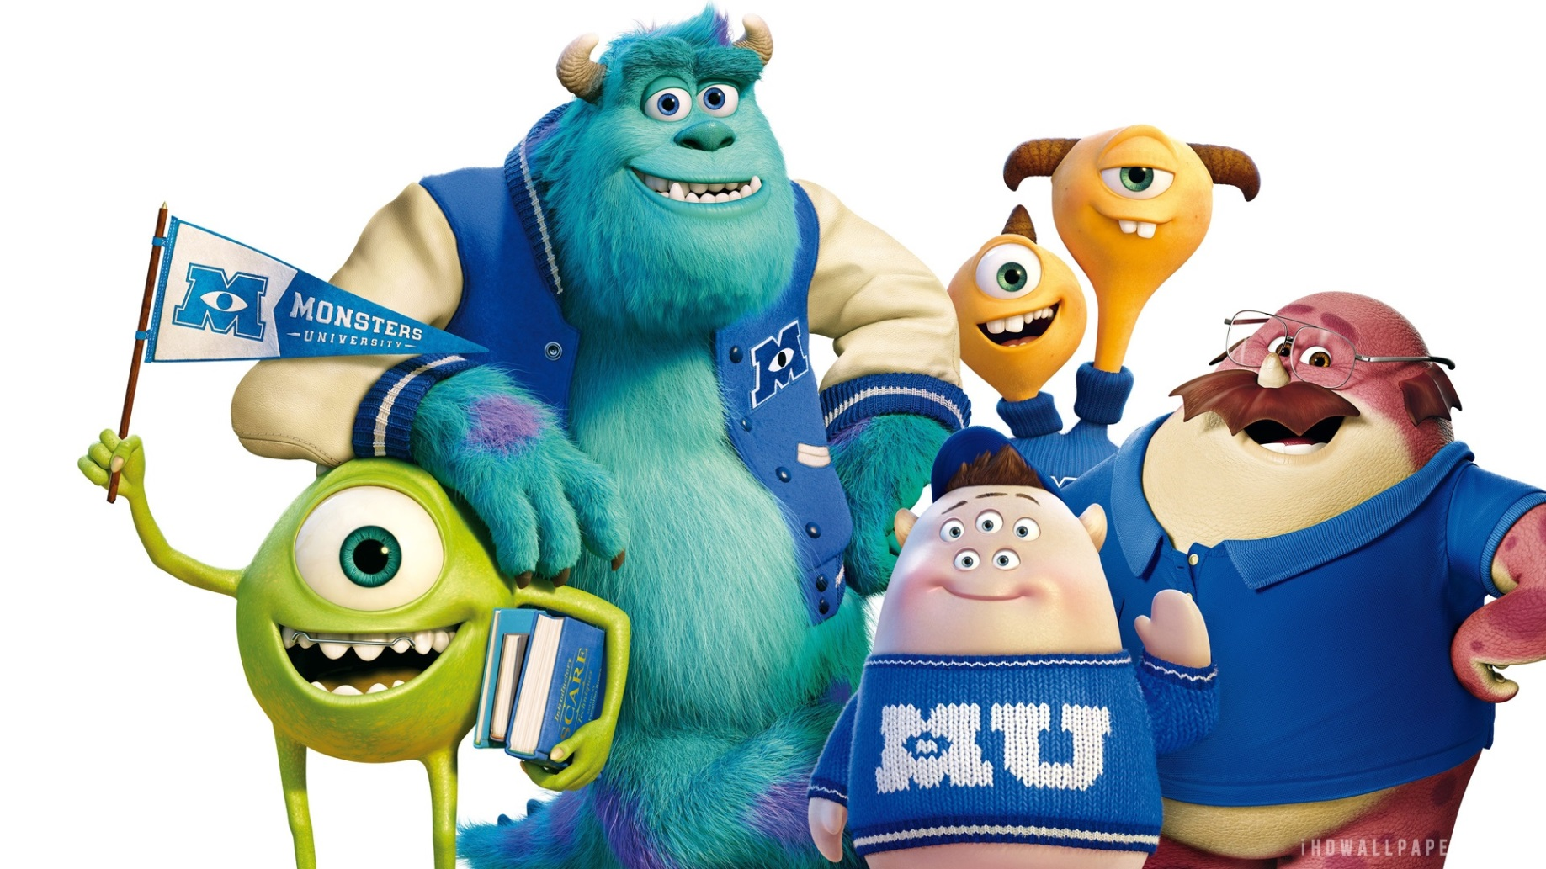
Attitude
How you feel and how you act DOES make a difference!

Slide 21

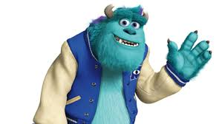
Emotion Zones
High +
Low +
High -
Low -

Slide 22
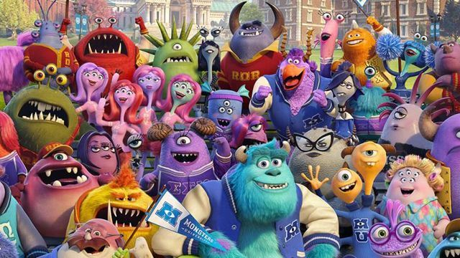
Guess the Emotion Zones
Which 2 are the best for a test?

Slide 23
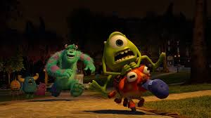
Take the Challenge
The Test Monsters can be…
  Scary
  Annoying
  Depressing
You are strong enough to win!
  Use what you learned today.

Slide 24
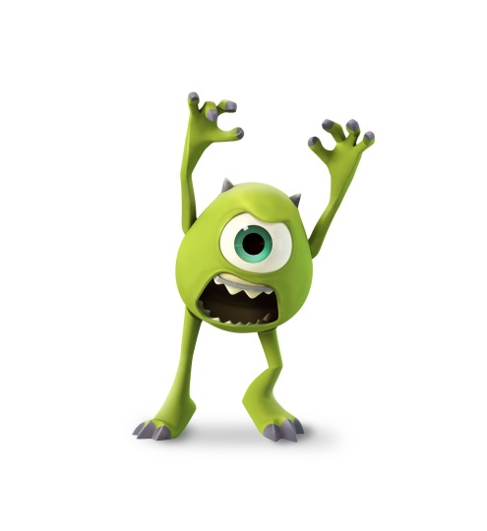
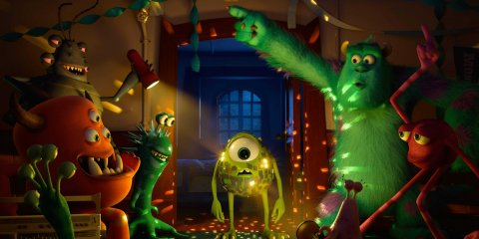

Your Turn to Roar
Do your best and you will shine!
Believe in yourself! It helps you do better on any type of test.

Slide 25
Good Luck!
You rock!

